Slide 1
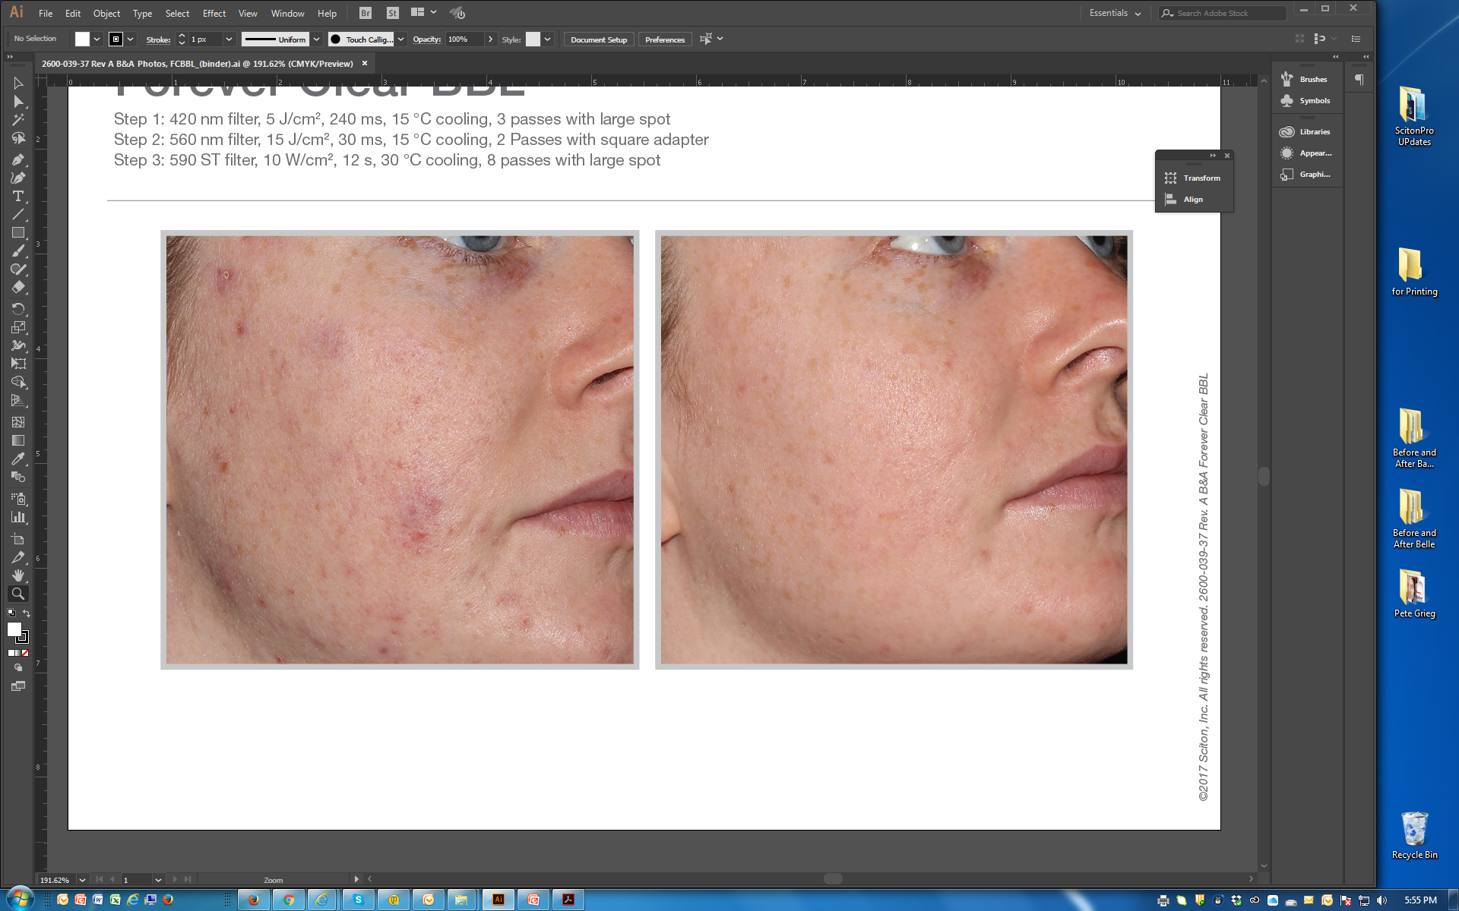
BEFORE / AFTER | 8 weeks post 5 tx | courtesy of Patrick Bitter, Jr., MD
Forever Clear BBL™
Step 1: 420 nm filter, 5 J/cm², 240 ms, 15 °C cooling, 3 passes with large spot
Step 2: 560 nm filter, 15 J/cm², 30 ms, 15 °C cooling, 2 Passes with square adapter
Step 3: 590 ST filter, 10 W/cm², 12 s, 30 °C cooling, 8 passes with large spot
©2017 Sciton, Inc. All rights reserved. 2600-039-37 Rev. A B&A FCBBL

